Slide 1

Department of Computer Science &Engineering Artificial Intelligence & Machine Learning A.P. Shah Institute of Technology
G. B. Road, Kasarvadavli, Thane(W), Mumbai-400615 UNIVERSITY OF MUMBAI Academic Year 2023-2024

Slide 2

Web Based Recipe Generator
Team Members
Christina D’Cruz (22106024) Haniya Akhtar (22106130) Nishat Khan (22106021) Kuheli Das (22106003)
Under The Guidance of
Prof. Taruna Sharma

Slide 3

A QUEST FOR ZEST
a website that helps generates recipes

Slide 4
INTRODUCTION
The core objective of this project is to develop a user-friendly and all-encompassing recipe generator, allowing users to explore, tailor, and generate an extensive array of recipes in line with their preferences.

Slide 5
OBJECTIVES
User Engagement and Retention
Content Quality and Diversity
User-Friendly Interface
Inspire Creativity and Experimentation
Accessibility and Inclusivity

Slide 6
Literature survey
Prominent examples include Allrecipes, BBC Good Food, and Yummly, each offering unique features and functionalities tailored to user preferences.
Analysis of Issues in Surveyed Solutions: Common issues present in surveyed solutions include limited adaptability to dietary restrictions and ingredient availability, lack of personalized recommendations, and difficulty in handling ambiguous instructions
Survey of User Requirements and Improvements Expected: Users expect intuitive interfaces, seamless integration with shopping lists, and options for ingredient substitutions. Additionally, there's a desire for community features such as user reviews and ratings.
Categorized Listing of Technologies and Methodologies Used:
Rule-Based Systems:
Natural Language Processing (NLP):

Slide 7
Limitations
Client-Side Validation Only
Security Vulnerabilities
Scalability and Maintainability
Limited User Interaction
Performance Considerations
Browser Compatibility

Slide 8
PROBLEM STATEMENT
The Recipe Generator project aims to address challenges in meal planning and cooking by proposing a web-based platform that uses advanced algorithms to curate personalized recipes based on user preferences, ingredient availability, and dietary restrictions. Traditional recipe platforms often fail to adapt to individual needs, resulting in a gap between desired culinary experiences and practical constraints. The project seeks to bridge this gap by providing a versatile and adaptive solution, facilitating an efficient and enjoyable cooking experience while encouraging culinary creativity and exploration.espite the abudannce of online recipes, there is a lack of platforms that offer a personalized and adaptable solution to cater to diverse user needs. Existing recipe websites often overwhelm users with an excess of information or fail to provide creative and tailored recipe suggestions.

Slide 9



Tools

Slide 10
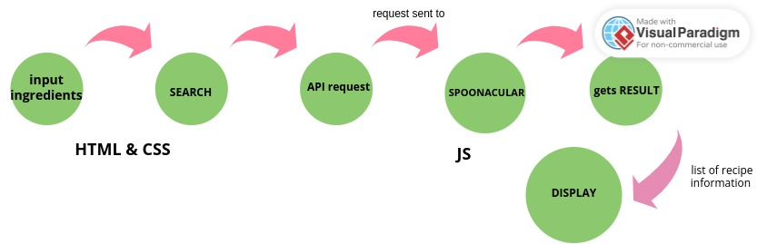
BLOCK DIAGRAM

Slide 11
IMPLEMENTATION

Slide 12
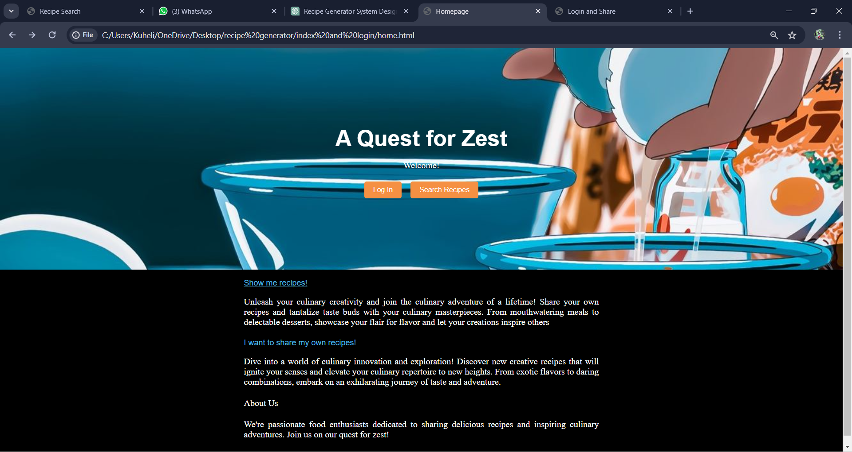

Slide 13
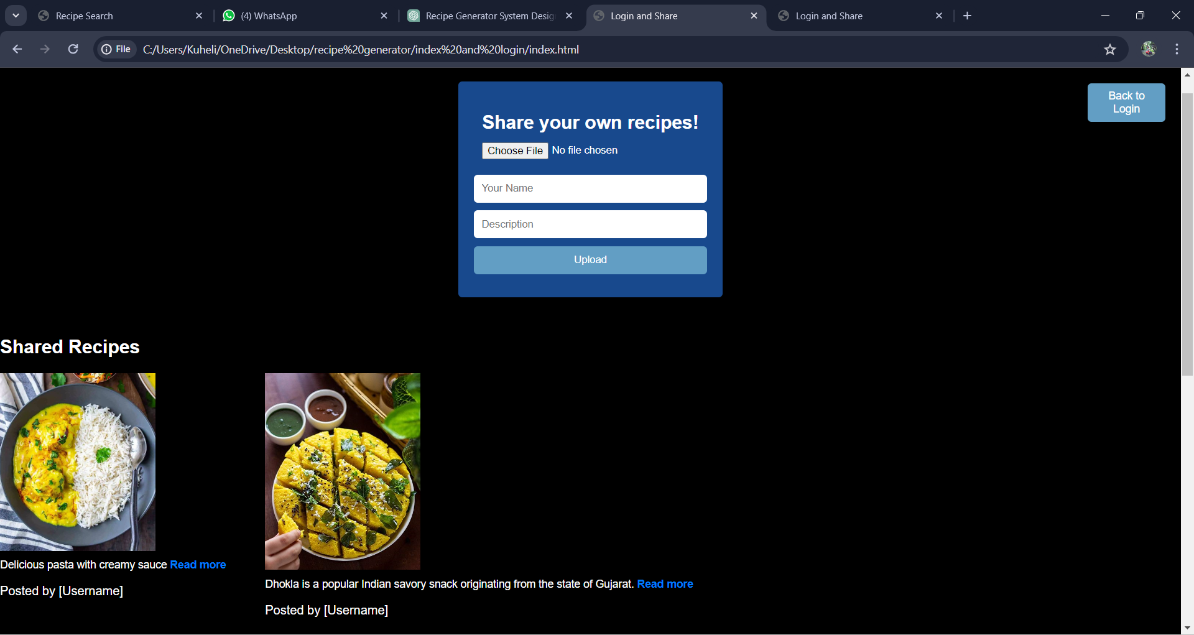

Slide 14
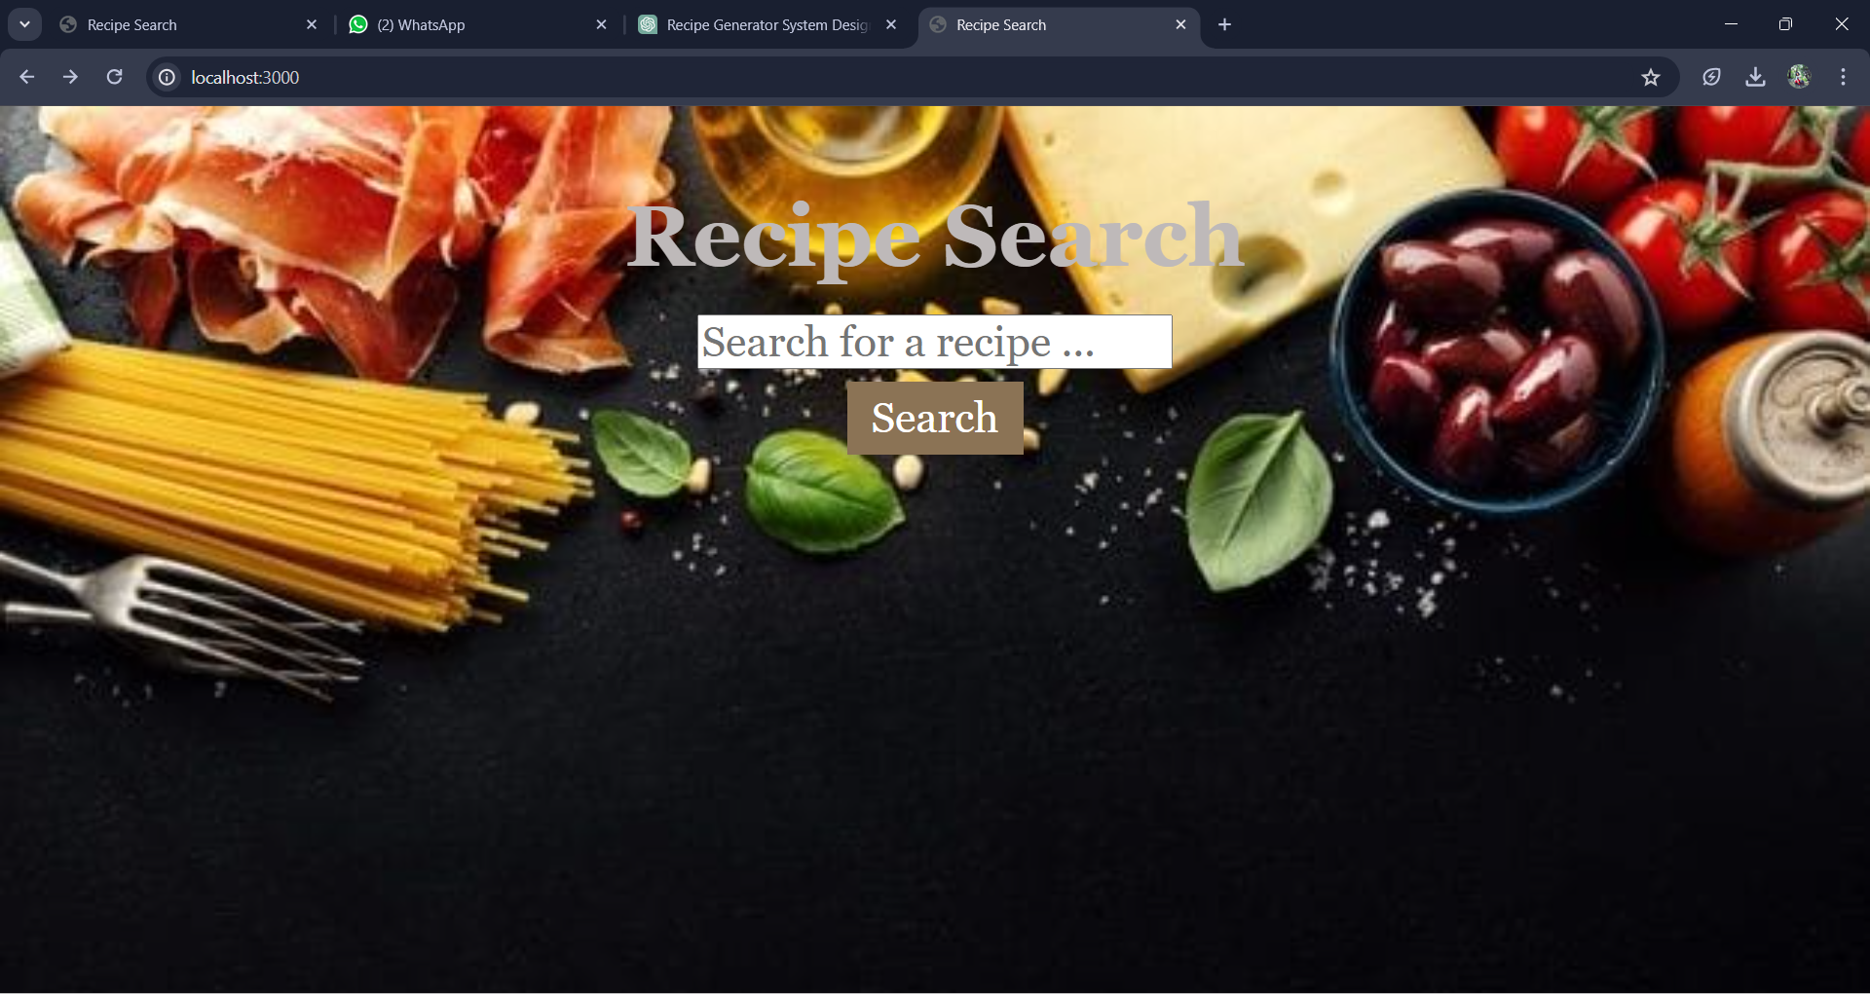

Slide 15
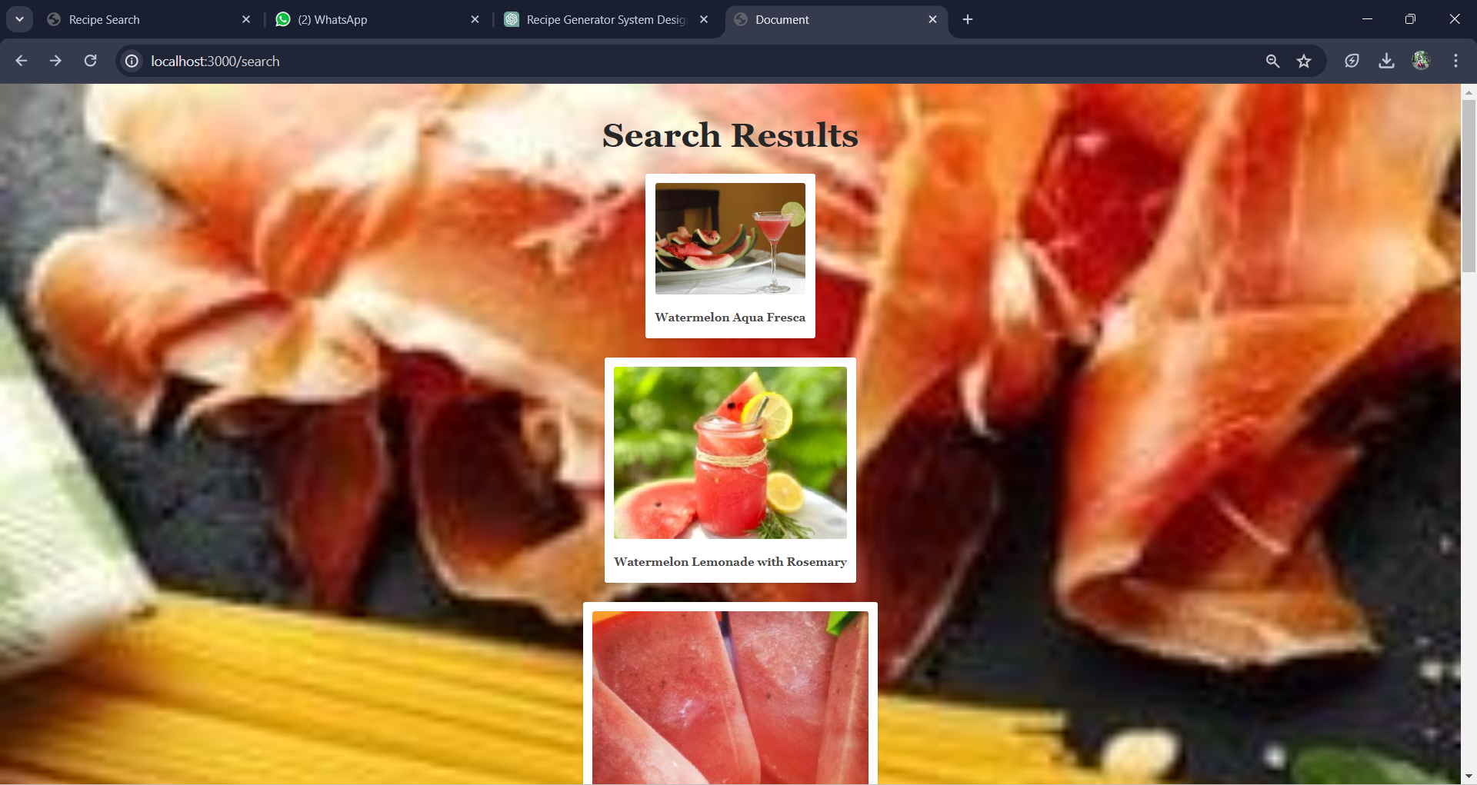

Slide 16
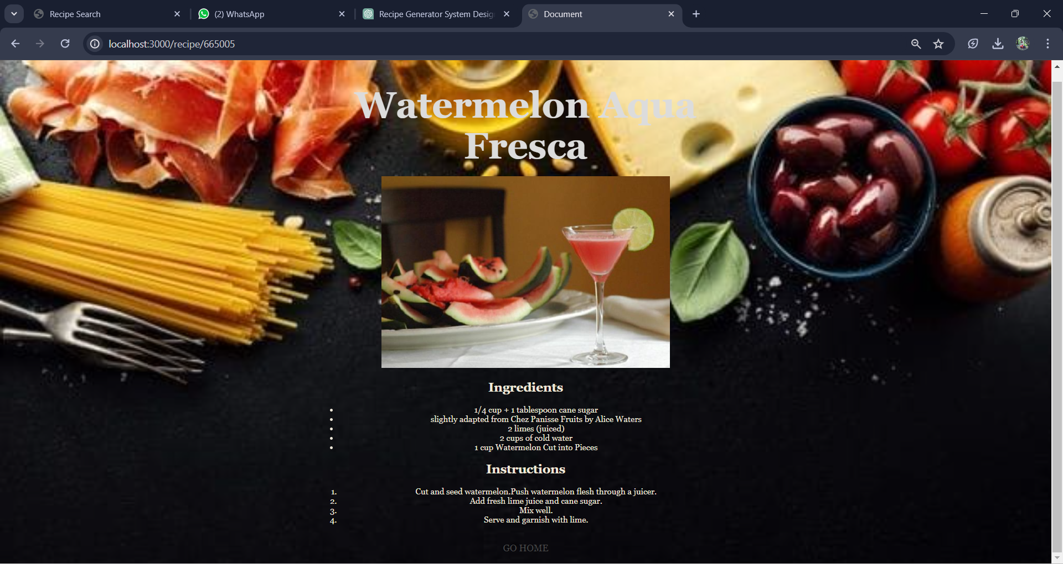

Slide 17
REFERENCES
Abhari, Shahabeddin, Reza Safdari, L. Azadbakht, K. B. Lankarani, Sh R. Niakan Kalhori, B. Honarvar, Kh Abhari et al. "A systematic review of nutrition recommendation systems: with focus on technical aspects." Journal of biomedical physics & engineering 9, no. 6 (2019): 591.
Kul, Seda, and Ahmet Sayar. "A Smart Recipe Recommendation System Based on Image Processing and Deep Learning." In The Proceedings of the International Conference on Smart City Applications, pp. 1023-1033. Cham: Springer International Publishing, 2021.
De Clercq, Marlies, Michiel Stock, Bernard De Baets, and Willem Waegeman. "Data-driven recipe completion using machine learning methods." Trends in Food Science & Technology 49 (2016): 1-13.
Mokdara, Tossawat, Priyakorn Pusawiro, and Jaturon Harnsomburana. "Personalized food recommendation using deep neural network." In 2018 Seventh ICT International Student Project Conference (ICT-ISPC), pp. 1-4. IEEE, 2018.

Slide 18
THANK YOU

